Slide 1

Project #3
BILLBOARD TOP CHARTS
TEAM MEMBERS:
ALEX LI
JEANIE WU
MARK WERDEN
ROBERT HARVEY

Slide 2

PROJECT DESCRIPTION
Our goal was to determine which musical artist had the most Top Billboard Chart hits from the period of 2014 – 2021; using various data analysis methods such as Postgres, JavaScript, Plotly, APIs, and more. The end-product is a dashboard that can be used to filter and visually display data in an easy-to-use, interactive, intuitive way. Dashboard users can find data using dropdown menus to sort and filter by both year and artist. The data displayed is dynamic and moves with the user, creating a fun experience.

Slide 3
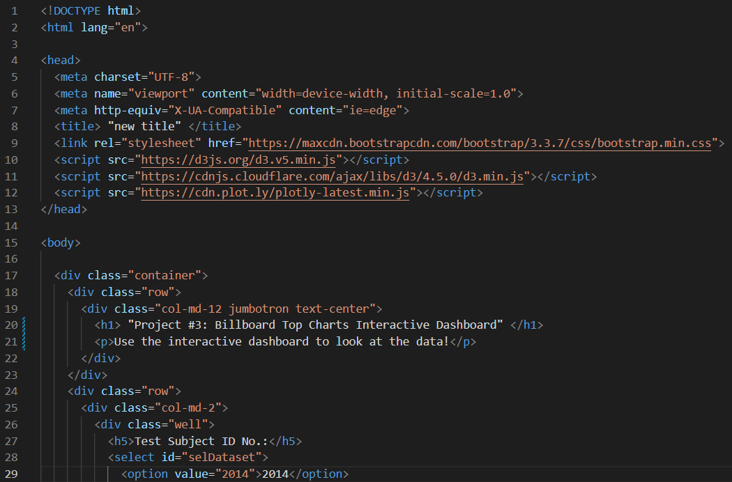
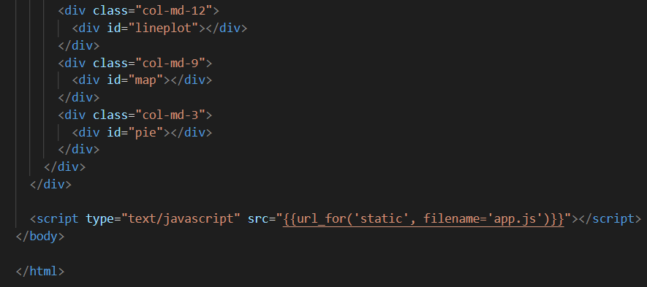
Index.html
Image #1: shows the beginning of the html script, including loading charset and src (d3), headers of various sizes, and formatting
Image #2: shows the end of the html script, which shows a line plot, map, and pie chart

Slide 4
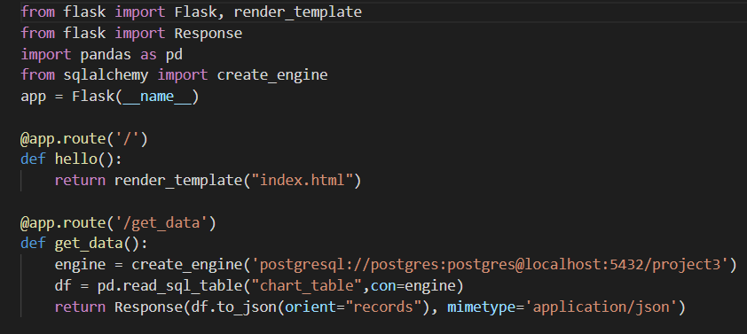
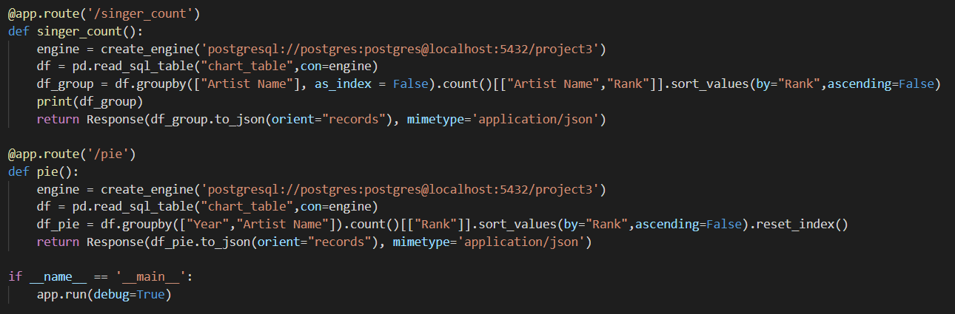
App.py
Image #1: shows the flask app, app route, def, return, creating engines, and creating dataframes reading sql database tables
Image #2: shows app route, def, return, creating engines, groupby, and debug

Slide 5
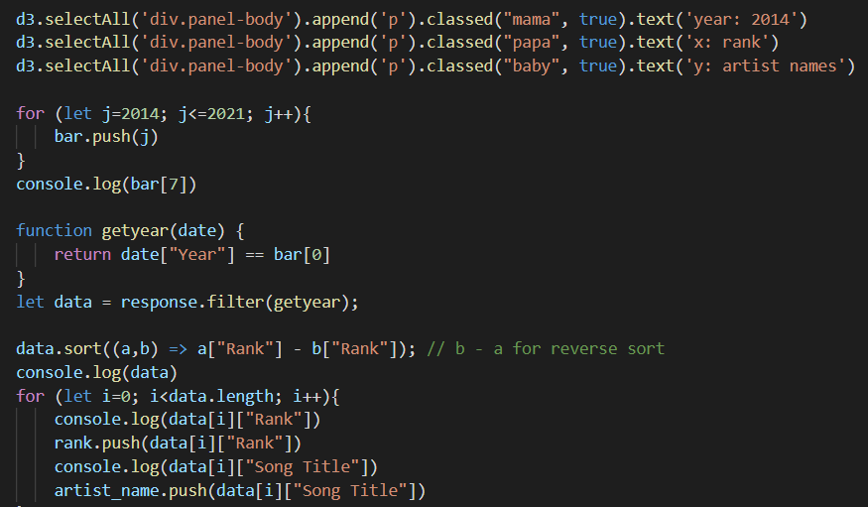
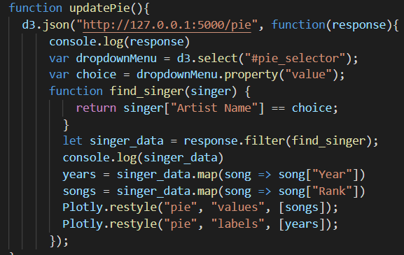
App.js
Image #1: shows the year range for the dataset (2014-2021), filtering by year, and sorting based on rank
Image #2: shows d3.json, var, functions, let, and Plotly

Slide 6
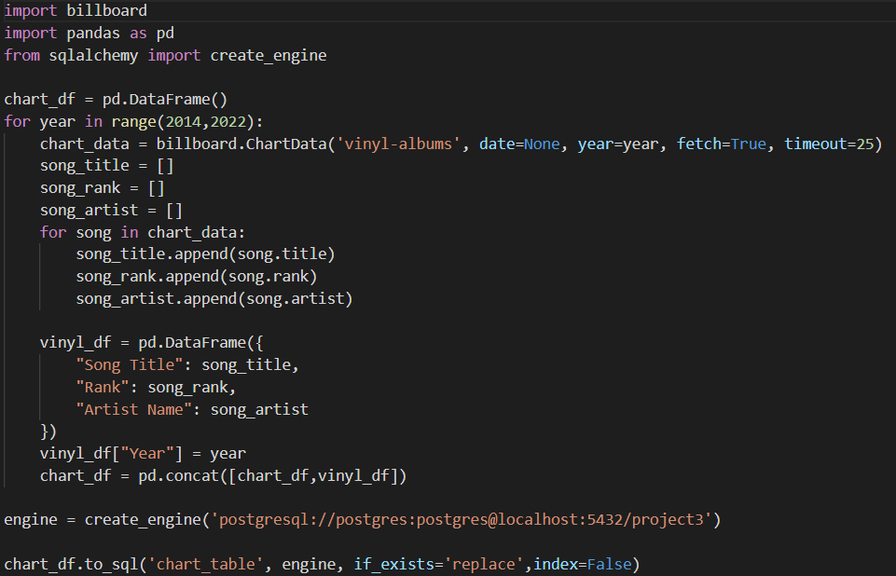
Database.py
The image above shows importing the necessary packages before cleaning the data. Then, a pandas dataframe is created to capture the chart_data, song_title, song_rank, and song_artist as lists. An engine is then created to connect to a postgres database, and the to_sql function is used to conclude the script

